Slide 1
Battle Turtles A Simplified Visual Representation of what is going when you program the CPU

Slide 2
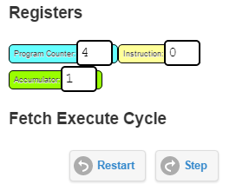
Tips and tricks
If you have run a program and it didn't quite work, you will need to Restart the CPU.
This will set the Program Counter back to 0.
Data labels must be at the bottom of your program.
Instructions: e.g. LDA Forward / OUT 1
End of program: HLT
Finally, data labels: e.g. Forward DAT 0

Slide 3
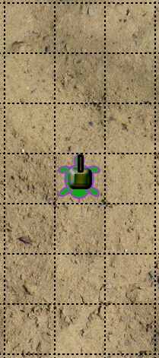
What does the program do?
// Commands
LDA Forward
OUT 1
HLT
// Data labels
Forward DAT 0
Backward DAT 1

Slide 4
What does the program do?
// Commands
LDA Forward
OUT 1
OUT 1
HLT
// Data labels
Forward DAT 0
Backward DAT 1

Slide 5
What does the program do?
// Commands
LDA
OUT 1
OUT 1
OUT 1
HLT
// Data labels
Forward DAT 0
Backward DAT 1
Forward

Slide 6
What does the program do?
// Commands
LDA Backward
OUT 1
LDA Forward
OUT 1
OUT 1
HLT
// Data labels
Forward DAT 0
Backward DAT 1

Slide 7
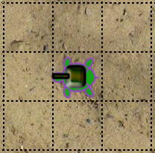
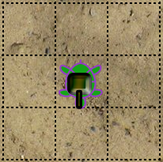
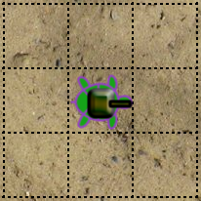
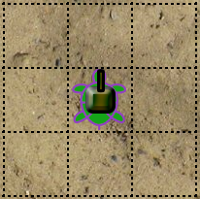
What does the program do?
// Commands
LDA West
OUT 2
HLT
// Data labels
Forward DAT 0
Backward DAT 1
North DAT 0
East DAT 2
South DAT 4
West DAT 6
1
2
3
4

Slide 8
What does the program do?
// Commands
LDA West
OUT 2
LDA South
OUT 2
HLT
// Data labels
Forward DAT 0
Backward DAT 1
North DAT 0
East DAT 2
South DAT 4
West DAT 6
1
2
3
4

Slide 9
What does the program do?
// Commands
LDA Forward
OUT 1
LDA East
OUT 2
LDA Forward
OUT 1
HLT
// Data labels
Forward DAT 0
Backward DAT 1
North DAT 0
East DAT 2
South DAT 4
West DAT 6

Slide 11
Hidden

